Slide 1

Online notes
Come and create your Online notes for free

Slide 2

Table of content
Introduction
Technology used.
Results

Slide 3

Introduction
Whether online or in-classroom, note-taking is a critical component of learning. It is also one of the best practices for exam preparation. The incorporation and utilization of electronic devices have been altering classroom dynamics in several ways, including how students take notes. And Now a days in this fast moving world where people have no time they can easily make their note online.

Slide 4
Key features
It is free to use.
It is accessible through phone.
Easy to use.
Portable.
Saves Time
Can easily edit and delete notes.
Can easily update you credentials

Slide 5

Why I chose this Project?
I have chosen this project because I can know sometime writing notes can be tiresome especially I you have a busy schedule. Also I can access this app through my phone so this notes will be with me all the time and I can create read notes wherever and whenever I get time.

Slide 6

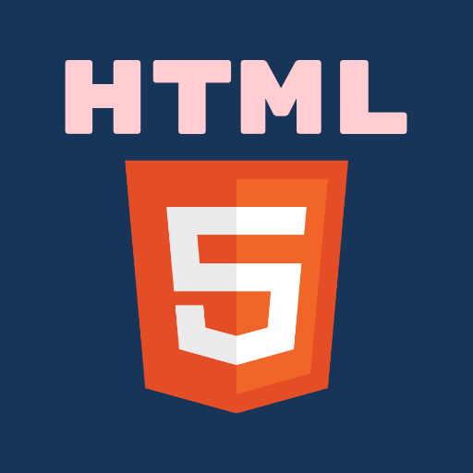
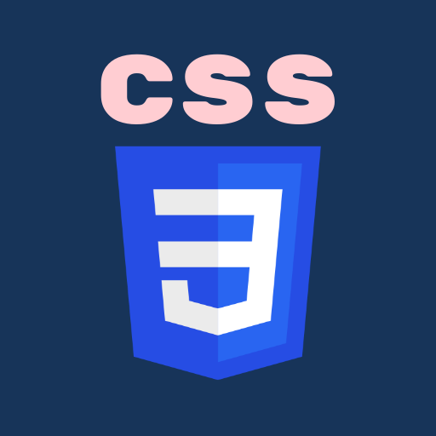




Technology used

Slide 7


Why I choose this technology?

Slide 8
<doctype html>
<html>
<head> <tittle>…..</title> </head>
<body>
<header>….. </header>
<nav>…….</nav>
<div class=“container”> …. </div>
<Footer>…. <Footer>
</body>
</html>
HTML stands for Hyper Text Markup Language. It is used to design the web pages. With the help of HTML, you can create a complete website structure. HTML is the combination of Hypertext and Markup language. Hypertext defines the link between the web pages and markup language defines the text document within the tag that define the structure of web pages.
Basic syntax

Slide 9
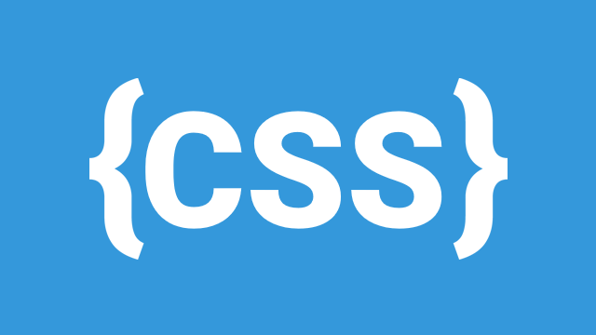
CSS stands for Cascading Style Sheet.
CSS is used to design HTML tags.
CSS is a widely used language on the web.
HTML, CSS and JavaScript are used for web designing. It helps the web designers to apply style on HTML tags.
Basic syntax
The CSS can be used internally using
<Style>……<style>
Or we can create a file and link it to our html file.
<head>
<link rel="stylesheet" type="text/css" href="mystyle.css">
</head>

Slide 10

Bootstrap is a free and open-source CSS framework directed at responsive, mobile-first front-end web development. It contains HTML, CSS and (optionally) JavaScript-based design templates for typography, forms, buttons, navigation, and other interface components.

Slide 11
It stands for Asynchronous JavaScript and XML. It is used to make asynchronous communication with the server. Ajax is used to read data from the server and update the page or send data to the server without affecting the current client page. Ajax is a programming concept.
$.ajax({arg1: value, arg2: value, ... });

Slide 12
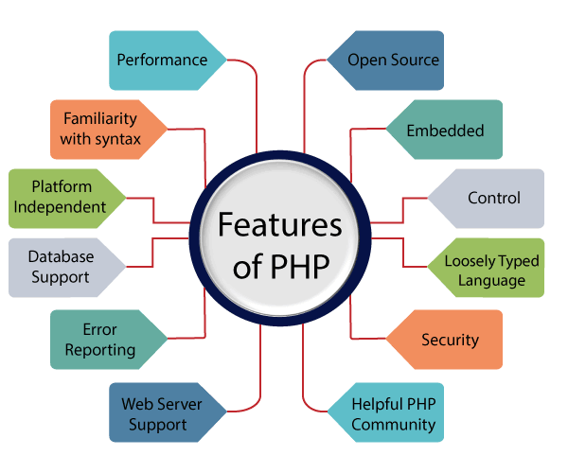
The PHP Hypertext Preprocessor (PHP) is a programming language that allows web developers to create dynamic content that interacts with databases. PHP is basically used for developing web based software applications. This tutorial helps you to build your base with PHP.
Basic Syntax:
<?php
/* echo is a print command */
echo "Hello world!";
?>

Slide 13

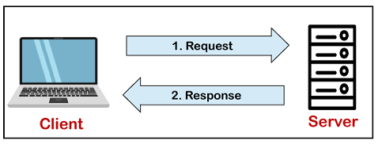
MySQL is a relational database management system based on the Structured Query Language, which is the popular language for accessing and managing the records in the database. MySQL is open-source and free software.
Basic syntax:
<?php $servername = "localhost"; $username = "username"; $password = "password"; // Create connection $conn = new mysqli($servername, $username, $password); ?>

Slide 14
Results

Slide 15
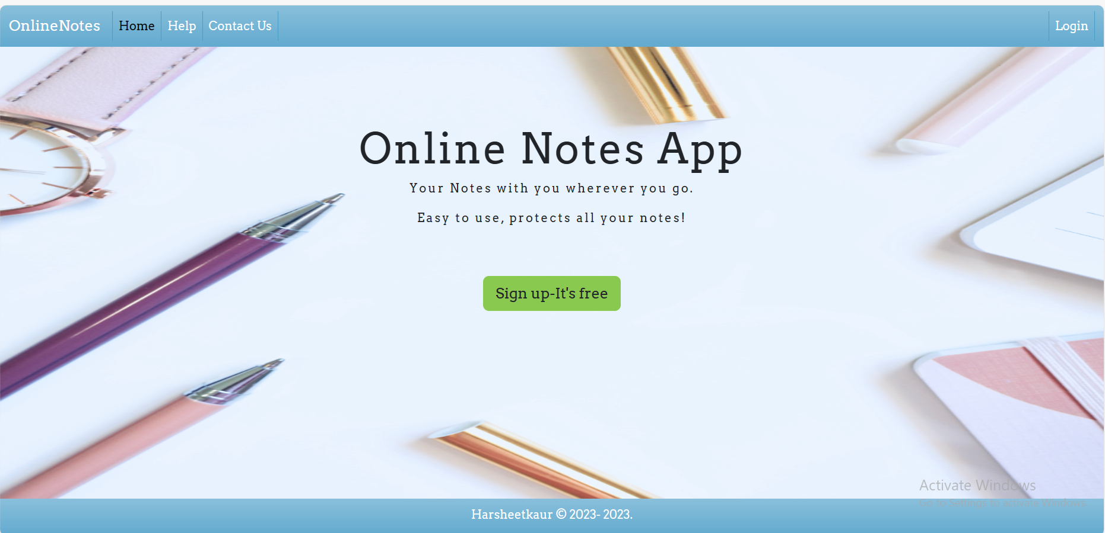
Main page

Slide 16
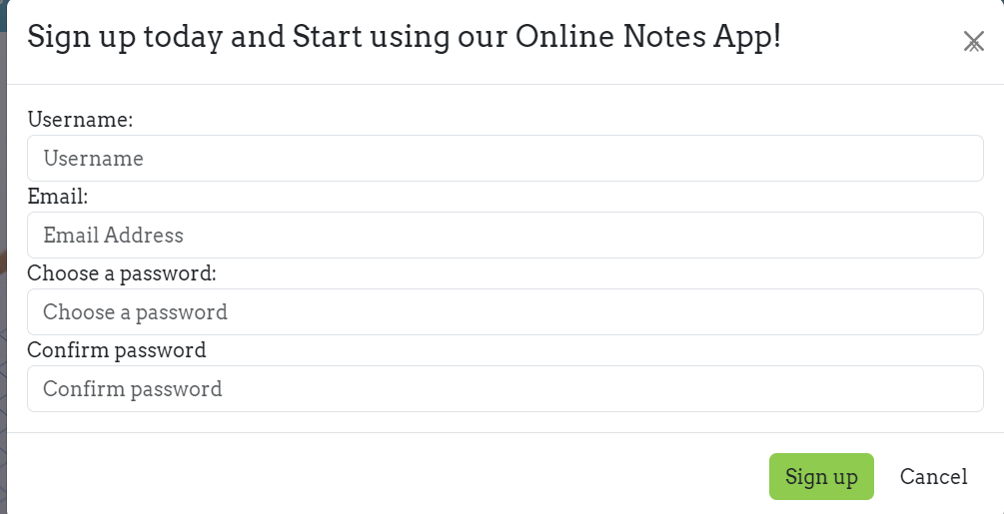

Slide 17
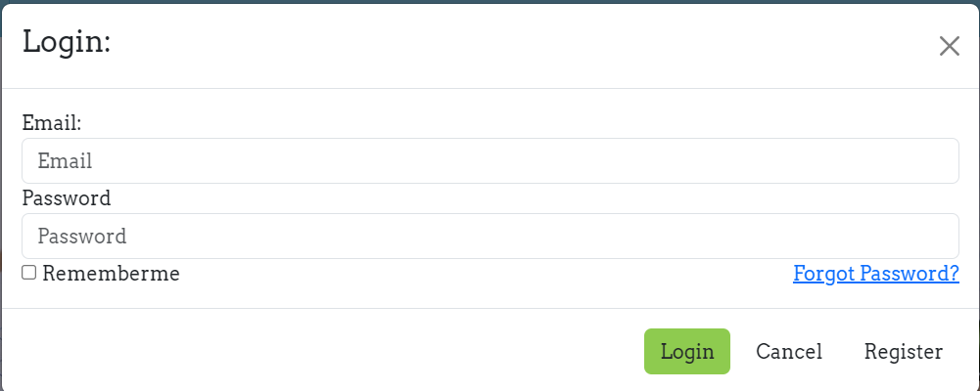
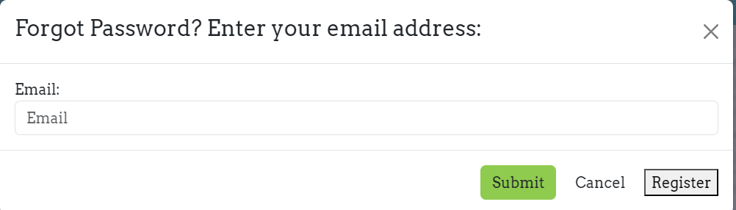

Slide 18
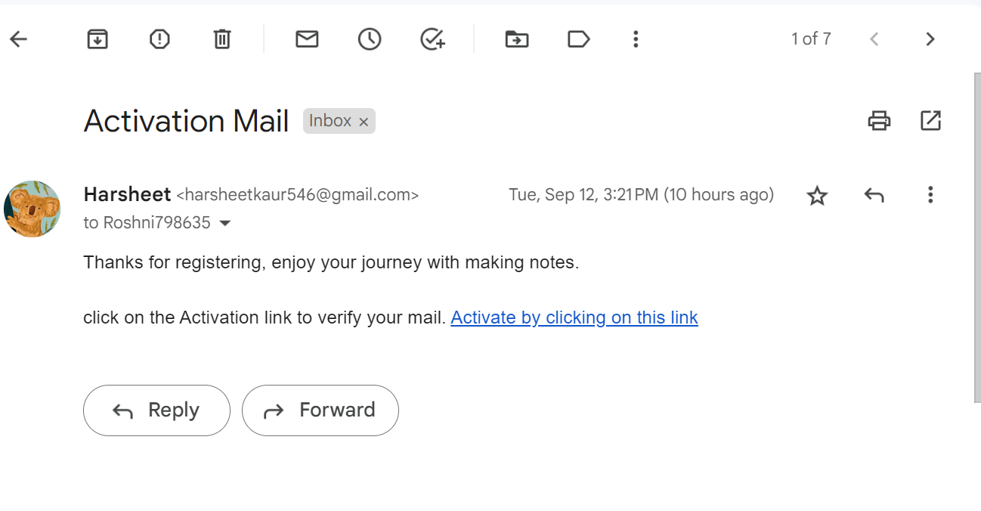
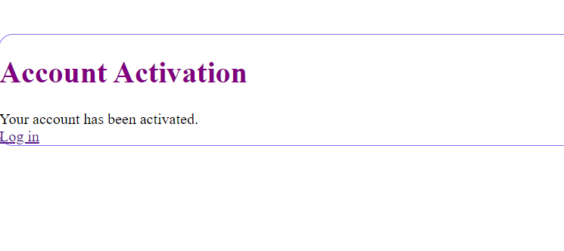

Slide 19
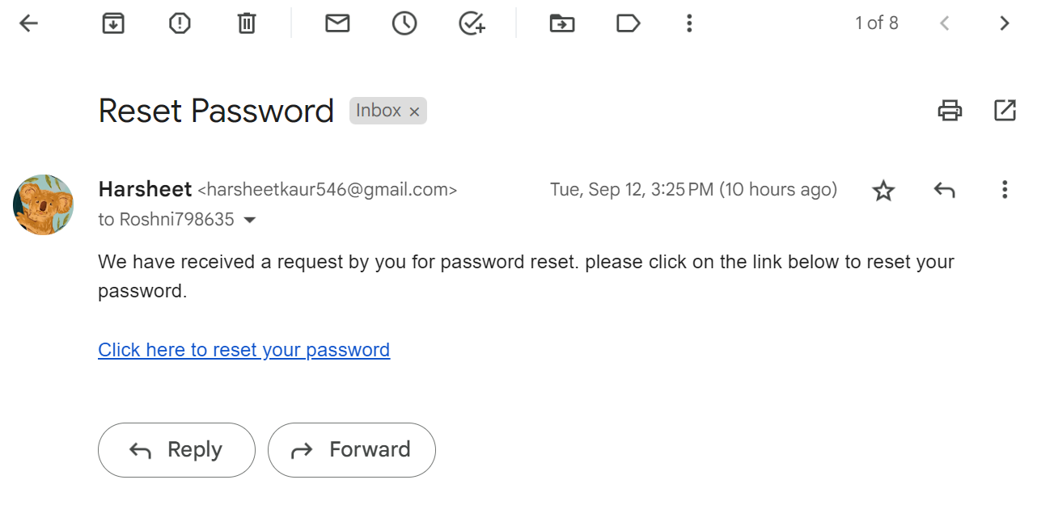
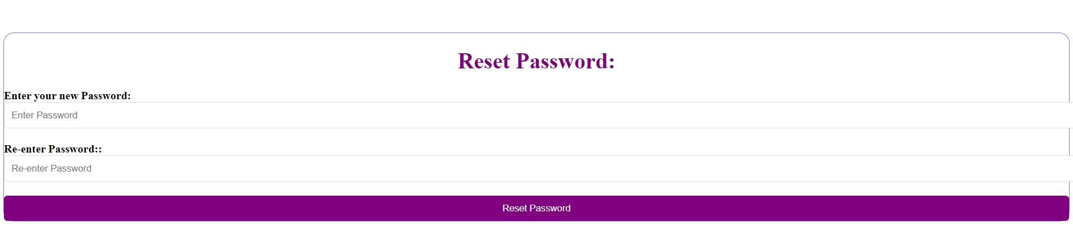

Slide 20
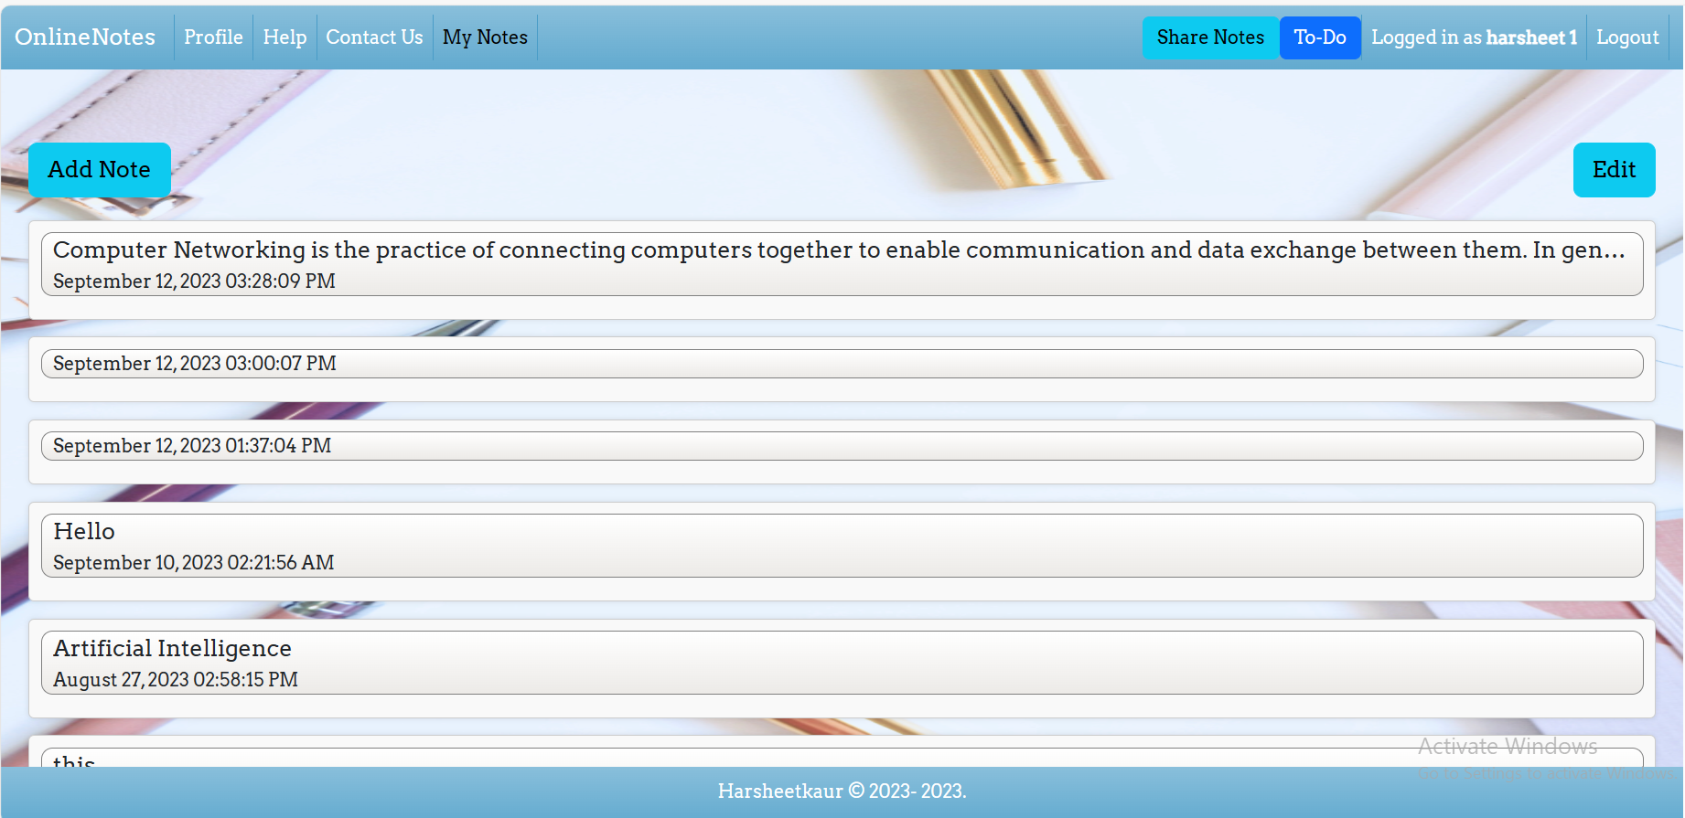

Slide 21
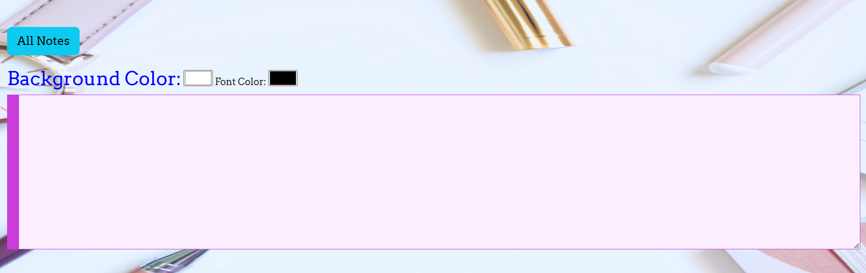

Slide 22
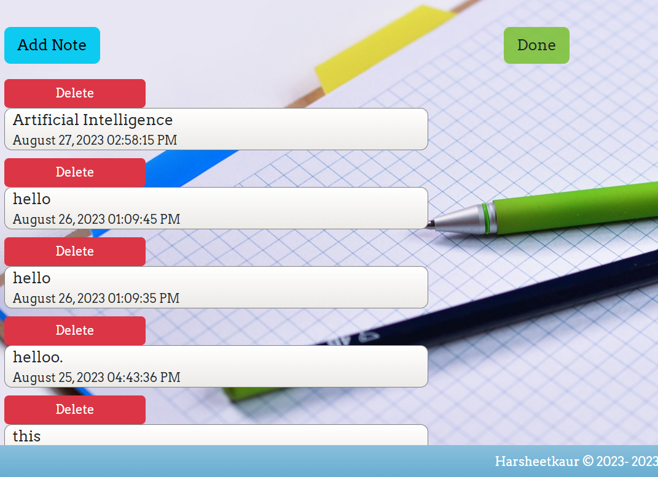

Slide 23

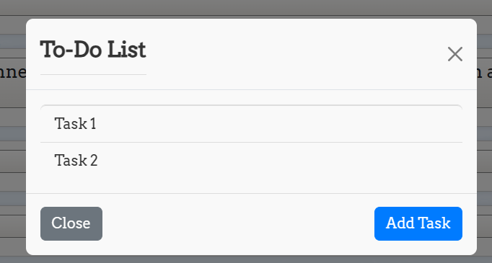
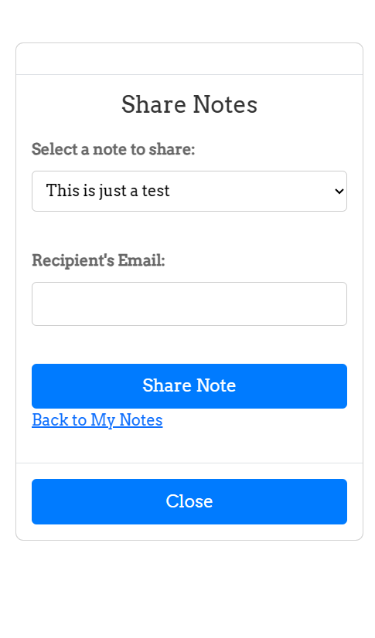
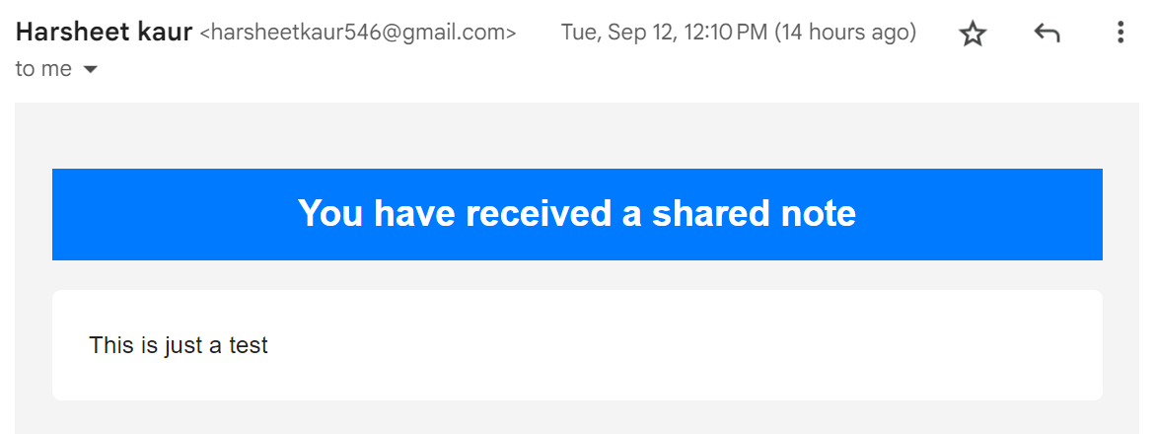

Slide 24
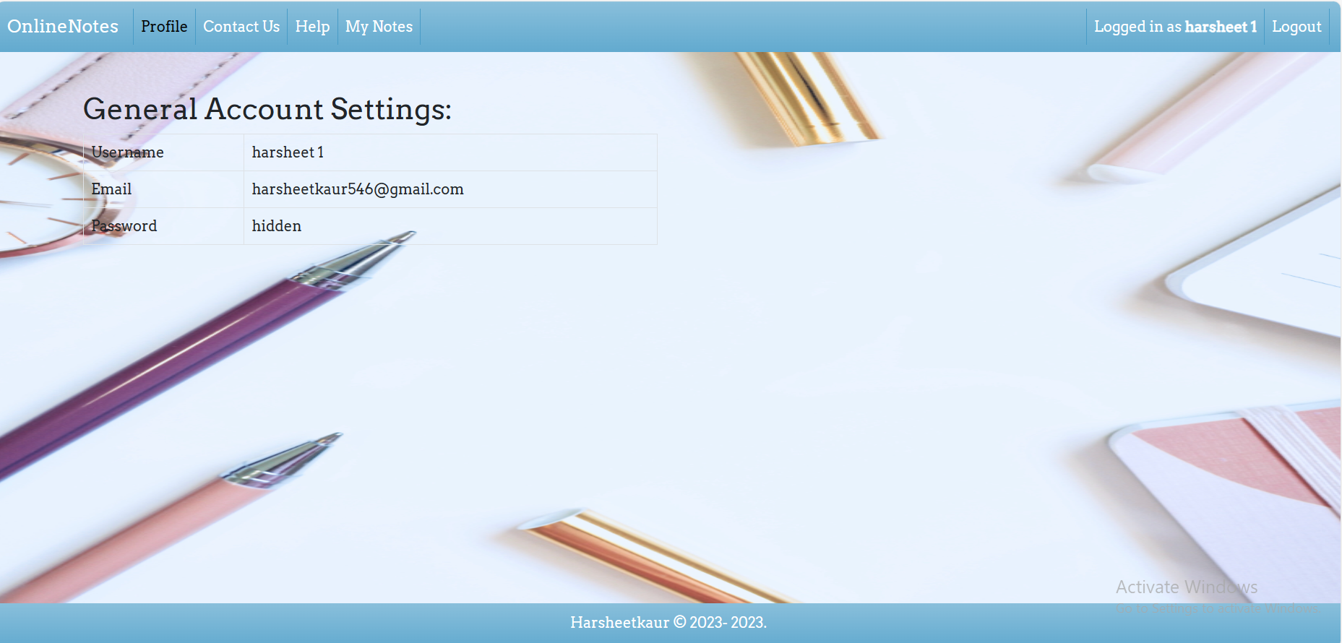
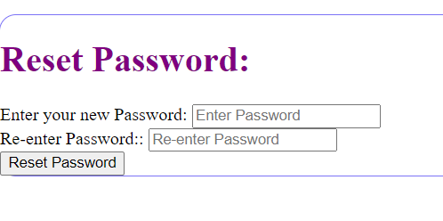

Slide 25
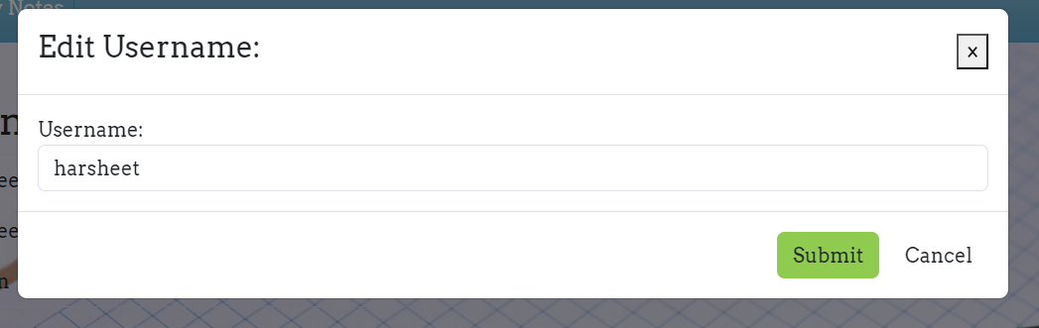
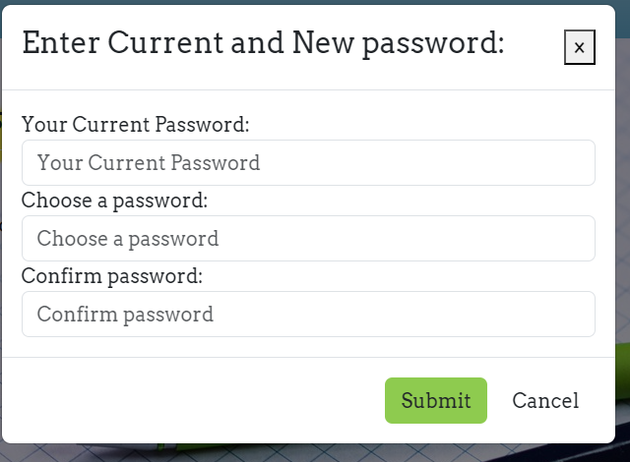

Slide 26
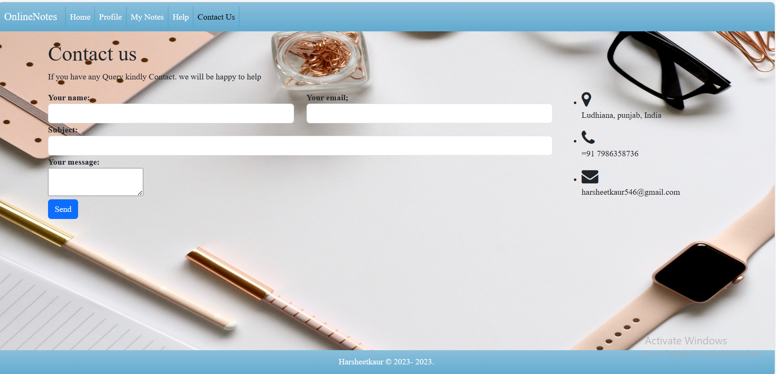

Slide 27
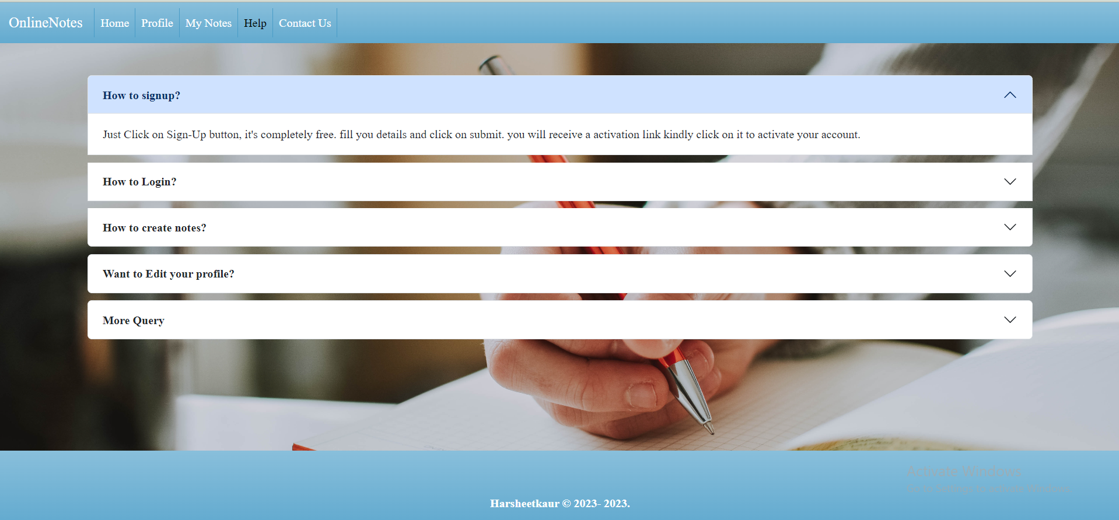

Slide 28
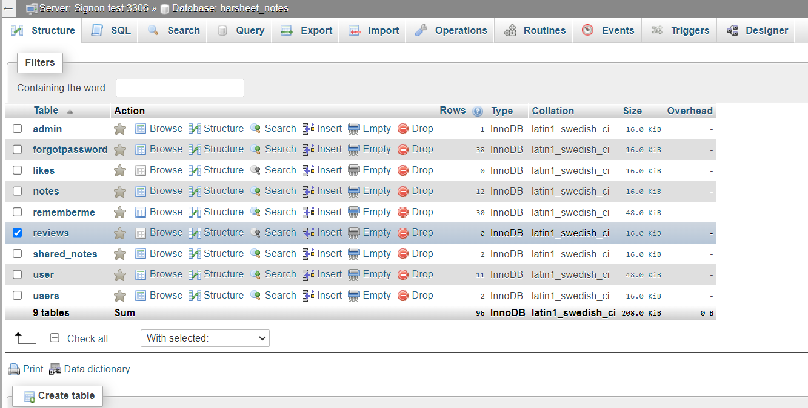

Slide 29
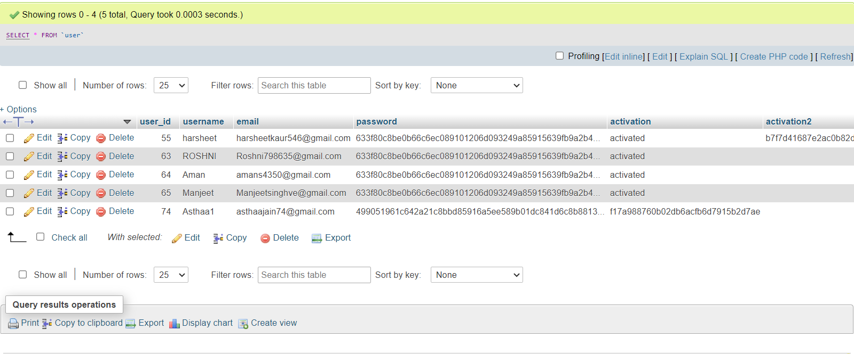

Slide 30
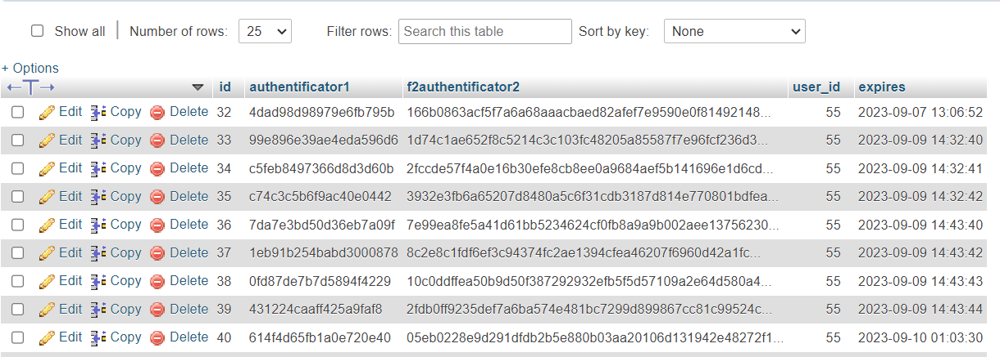

Slide 31
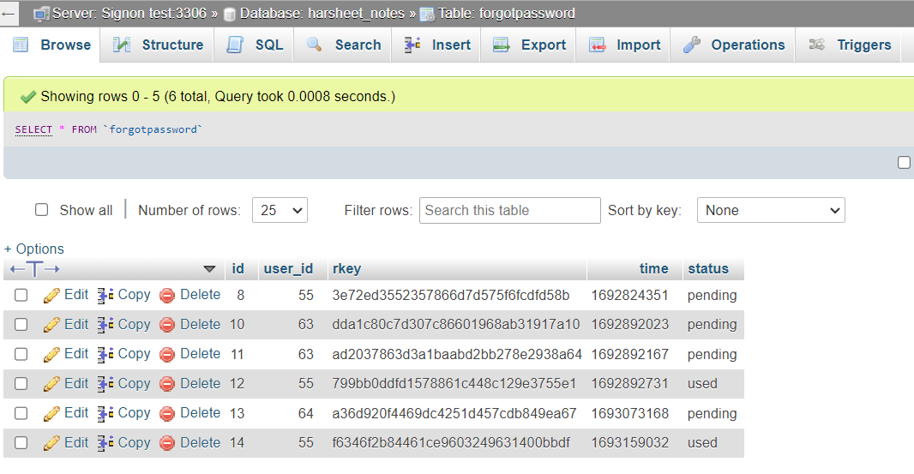

Slide 32
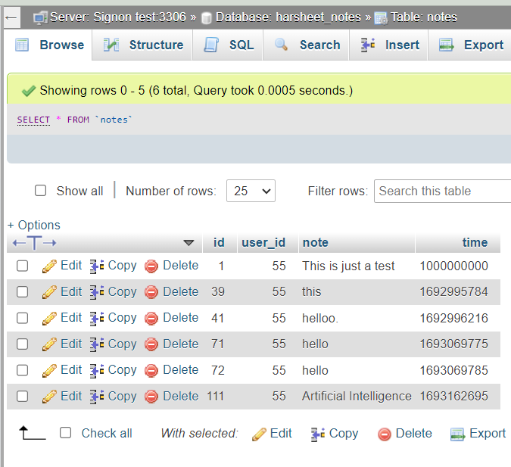
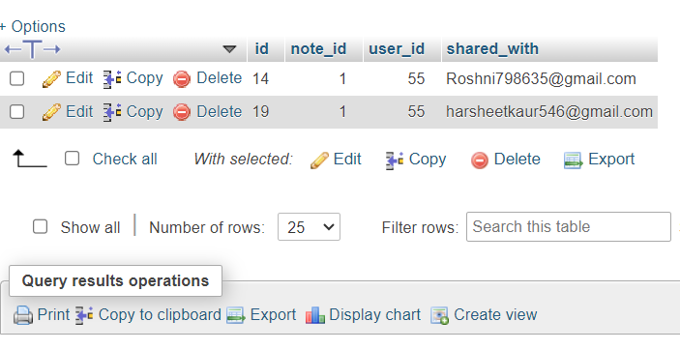

Slide 33


